Slide 1
Tracking Visibility Changes with Chemical Species for Regional Haze Planning
WRAP Regional Haze Planning Work Group
June 29, 2017
Pat Brewer (NPS ARD)
Tom Moore (WESTAR and WRAP)

Slide 2
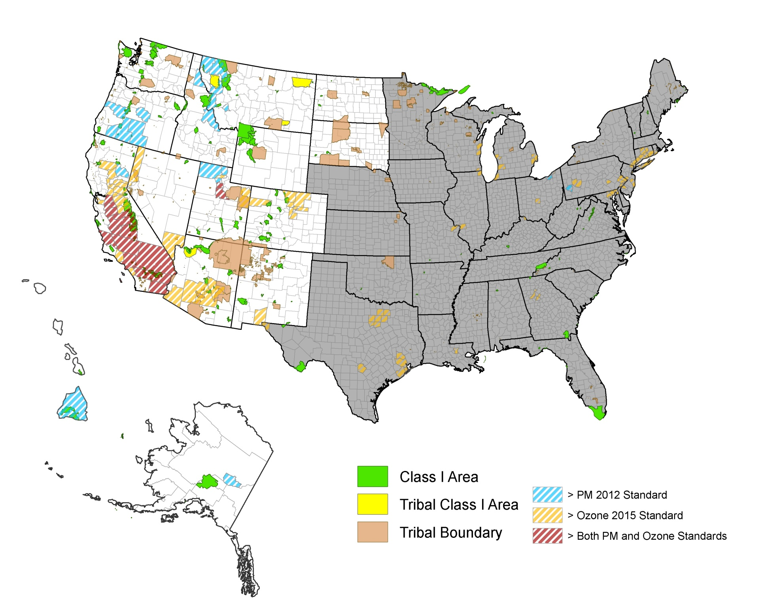
PRELIMINARY DESIGN
VALUES by COUNTY*
(AQS data 2013 – 2015)
Alaska and Hawaii at reduced scale
*Based on monitor with
highest value in county

Slide 3
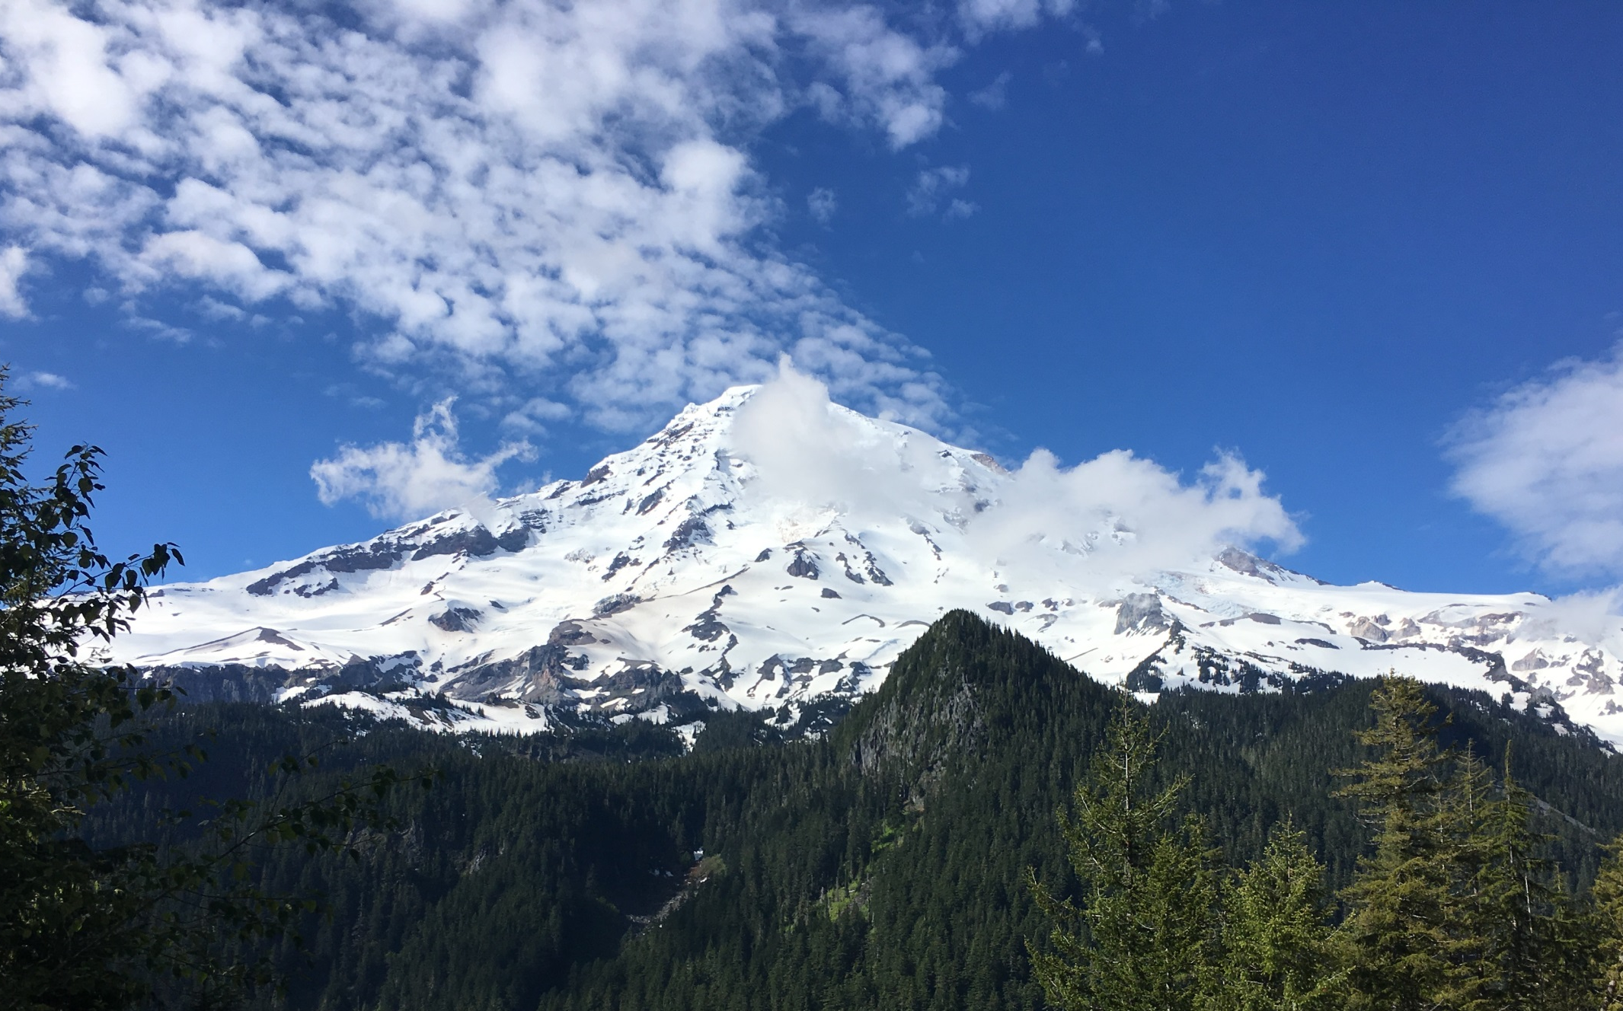
Proposed Revised Tracking Metric for 20% most impaired days
Mount Rainier National Park

Slide 4
Metric is a new approach to track Progress to Natural Conditions (?) (not fully released / finalized)
(used to be) 20% Worst & Best annual average visibility days
W & B based on 24ish samples/year, 5-year average baseline for planning
RHR plans addressed those targets - objective, extreme ends of monitoring data
Unchanged for more than 30 years until 2016
Now Visibility Impairment is going to be a Relative Contribution
Any humanly perceptible change in visibility (light extinction, visual range, contrast, coloration) from that which would have existed under natural conditions.
So, much different than the impairment a visitor is actually experiencing
For Regional Haze planning, states can decide to use their metric of choice – complex choice for future discussion.

Slide 5
Regional haze is cumulative impact from many diverse emissions sources
EPA proposes/d to use IMPROVE monitoring data to track progress on most impaired days
Days with highest fraction of total haze attributed to anthropogenic emissions (defined via chemical species on filter)
“Natural Haze” (again defined via chemical species) is to be divided into 2 parts:
Routine – background natural haze levels that occur on most days of the year. The values are more consistent from year to year and result from a mix of natural sources including vegetation, long range transported smoke, “typical” wind blown dust, etc.
Episodic – Relatively infrequent natural haze events that add to the routine levels. Episodes generally differ in size, number and time of occurrence from year to year, e.g. smoke and dust events
Light Extinction
(Bext)
Anthropogenic
Natural Haze
One day of reconstructed haze

Slide 6
Statistical apportionment of IMPROVE monitoring data
Split estimated natural from anthropogenic pollutant contribution
Episodic natural carbon and dust (wildfire and dust storms): daily values > 95th % of site’s 2000-2014 data
Routine daily natural: constant fraction of daily site- specific pollutant data
Pollutants that are not defined as natural, are presumed to be from U.S. anthropogenic sources
Contributions from international emissions are not separated from U.S. anthro impairment
Uncertainty in source allocation of carbon and dust

Slide 7
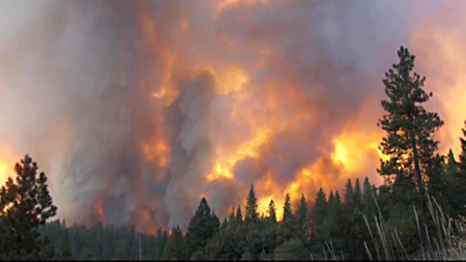
Wildland fire impacts air quality… can we remove
influence of fire on visibility tracking metric?
Rim Fire, Yosemite National Park, 2013

Slide 8
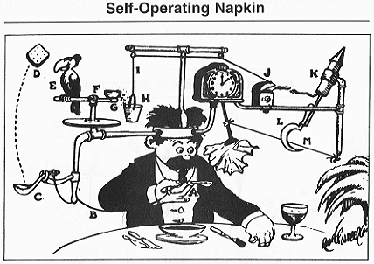
Reuben Garrett Lucius "Rube" Goldberg (July 4, 1883 – December 7, 1970) was an American cartoonist, sculptor, author, engineer, and inventor.
Goldberg is best known for a series of popular cartoons depicting complicated gadgets that perform simple tasks in indirect, convoluted ways, giving rise to the term Rube Goldberg machines for any similar gadget or process.

Slide 9
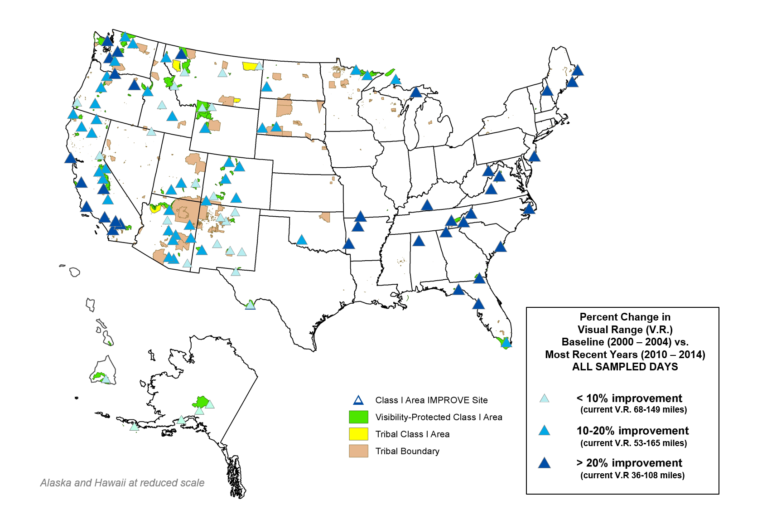

Slide 10
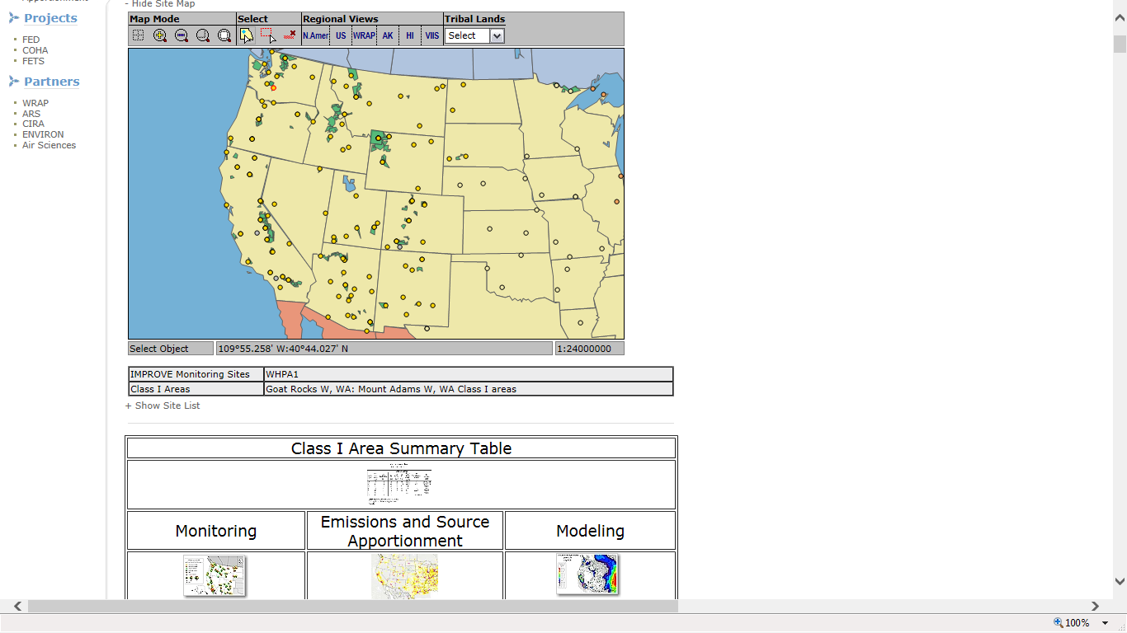
WRAP Regional Haze – Technical Support System (TSS) http://vista.cira.colostate.edu/TSS/Results/HazePlanning.aspx

Slide 11
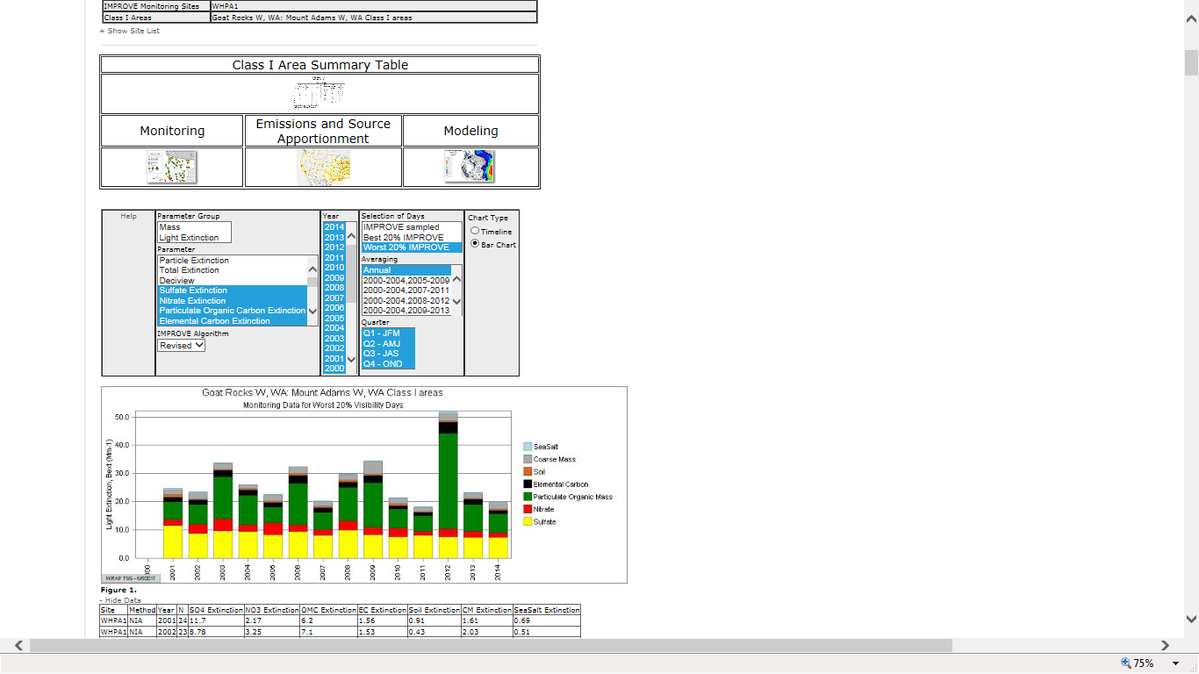
WRAP Regional Haze – Technical Support System (TSS) http://vista.cira.colostate.edu/TSS/Results/HazePlanning.aspx

Slide 12
Selected examples of monitoring data processing

Slide 13
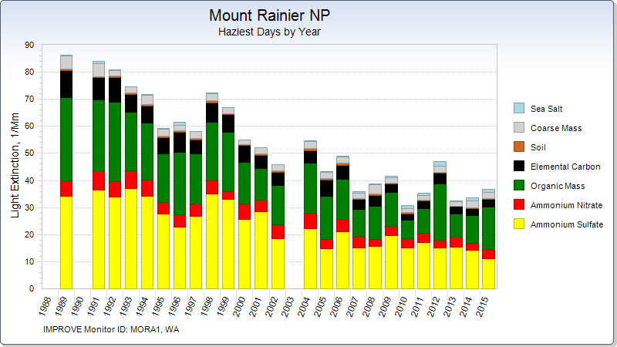

Slide 15
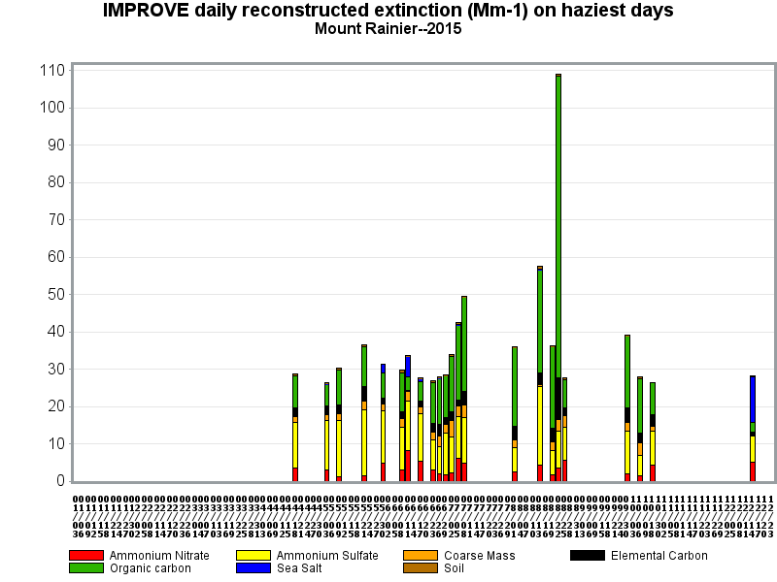
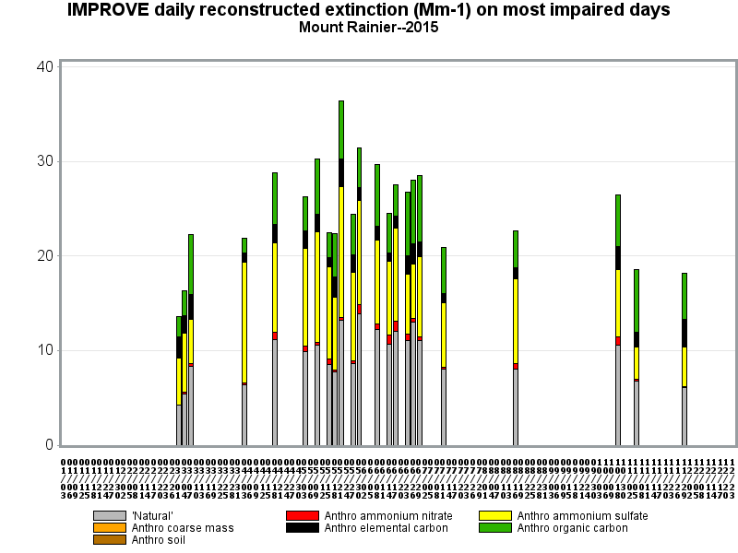
Light Extinction, 1/Mm
Light Extinction, 1/Mm

Slide 16
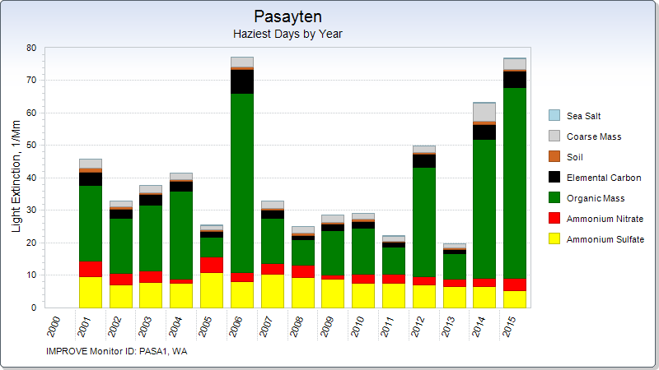

Slide 18
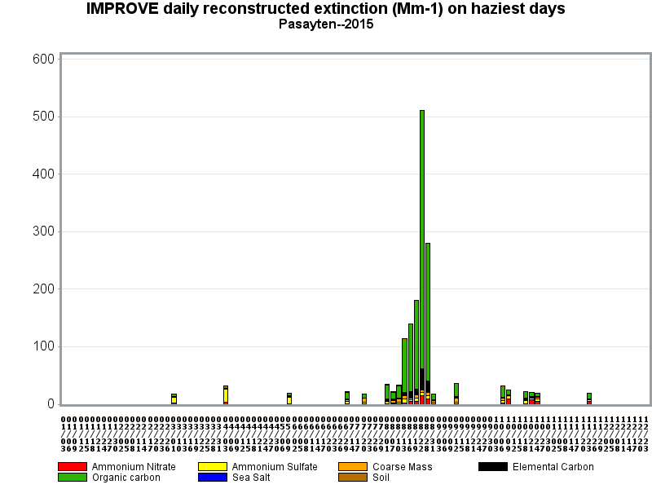
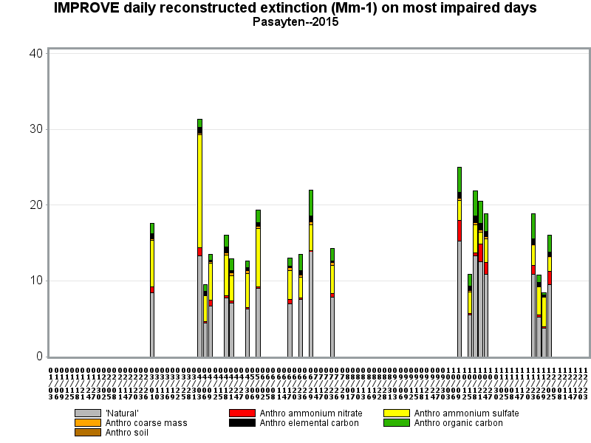
Light Extinction, 1/Mm
Light Extinction, 1/Mm

Slide 19
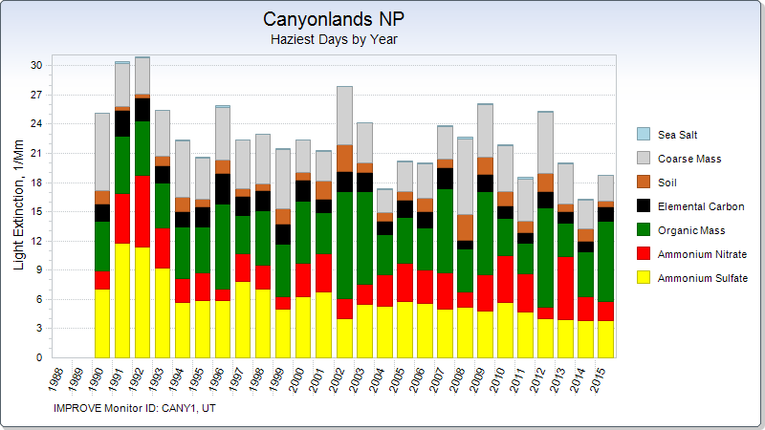
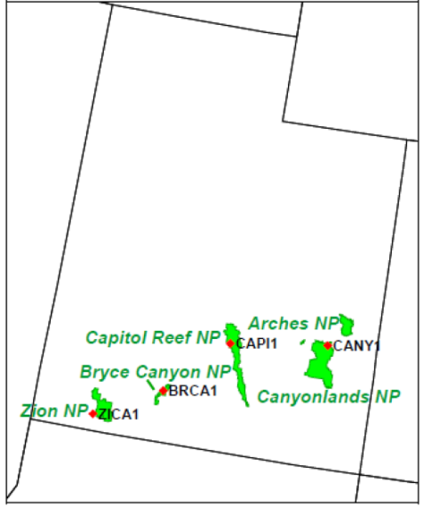

Slide 21
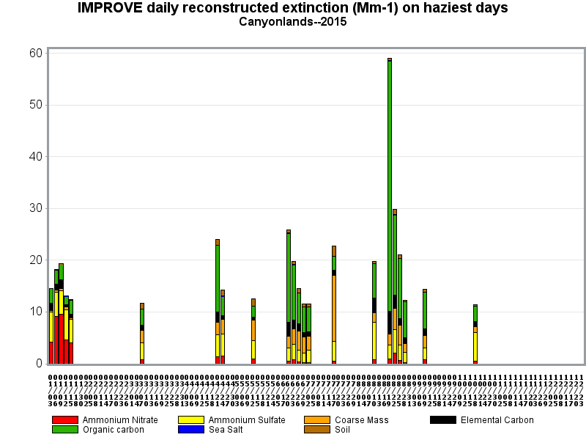
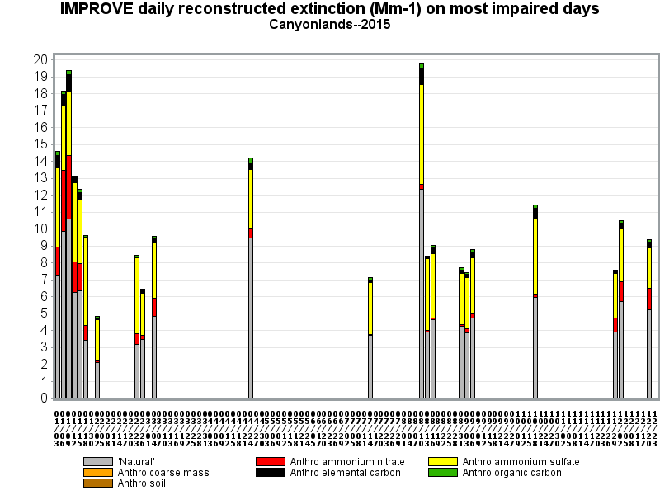
Light Extinction, 1/Mm
Light Extinction, 1/Mm

Slide 22
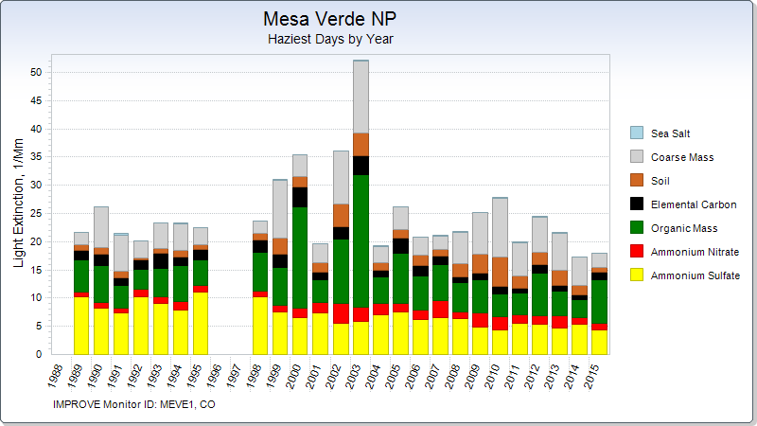
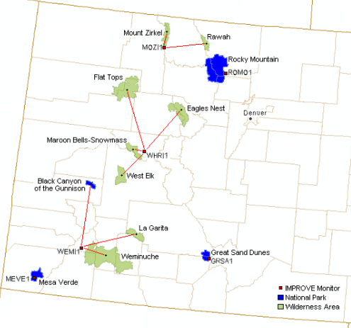

Slide 24
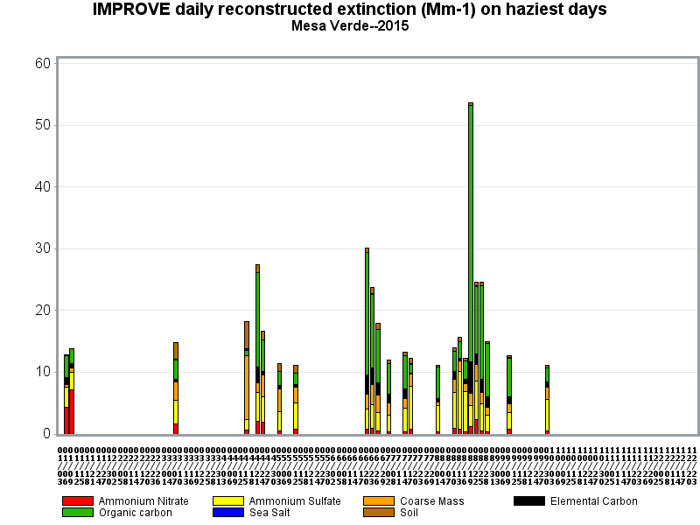
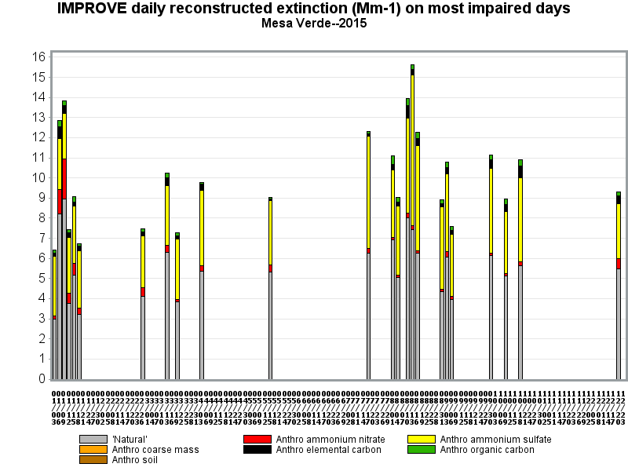
Light Extinction, 1/Mm
Light Extinction, 1/Mm

Slide 25
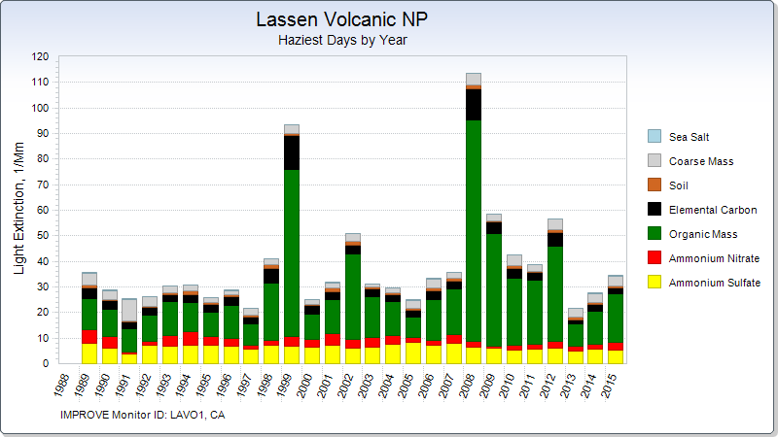
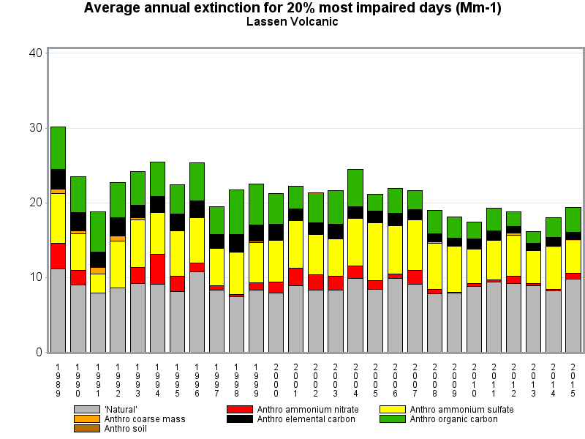

Slide 26
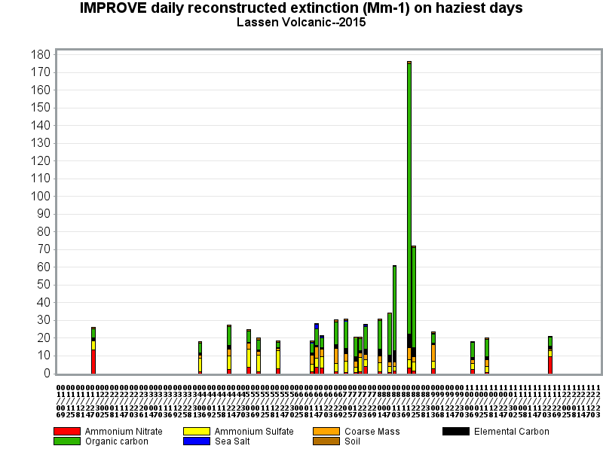
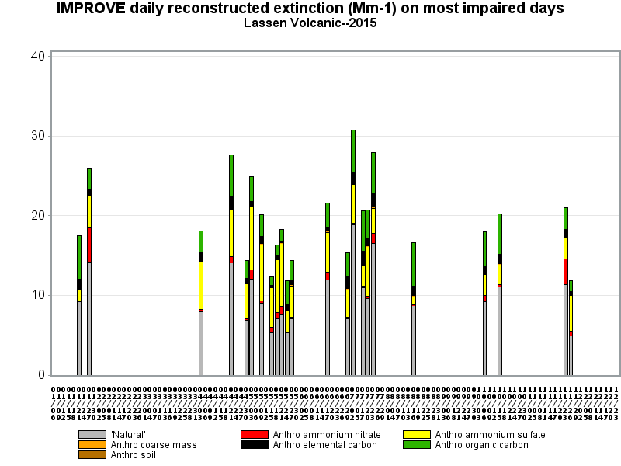
Light Extinction, 1/Mm
Light Extinction, 1/Mm

Slide 28
Haziest days and most impaired days:
Same days in the East
Different days, different
pollutants in the West

Slide 29
Preview of how the days selected for Regional Haze planning at each Class I areas are evaluated with regional photochemical modeling

Slide 30
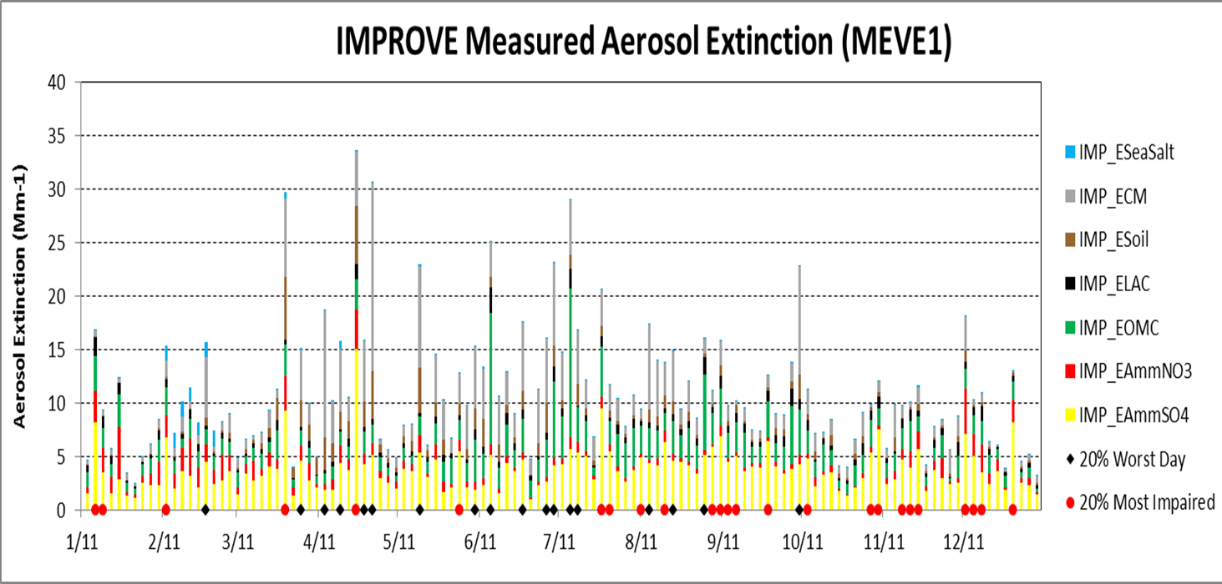
Most Impaired Days mostly eliminate Summer days (wildfire, dust)
Shift to Fall and Winter days (nitrate and sulfate)
Black Diamonds indicate 20% Worst Visibility Days
Red Diamonds indicate 20% Most Impaired Days
Notes:
20% worst days are indicated by black diamonds on x axis. New 20% most impaired days are illustrated by red diamonds. EPA used statistical methods to define natural vs anthropogenic contribution in the monitoring data.
When you focus on most impaired days, eliminate summer days influence by wildfire and dust, and shift to more fall and winter days where sulfate and nitrate are largest fraction of total haze.
Next step is to use source apportionment modeling to tag the emissions sources that contribute the days defined by EPA statistical methods as most impaired.
I know the proposed methods are imperfect, question is whether they are an improvement, whether they are workable for state planning.

Slide 33
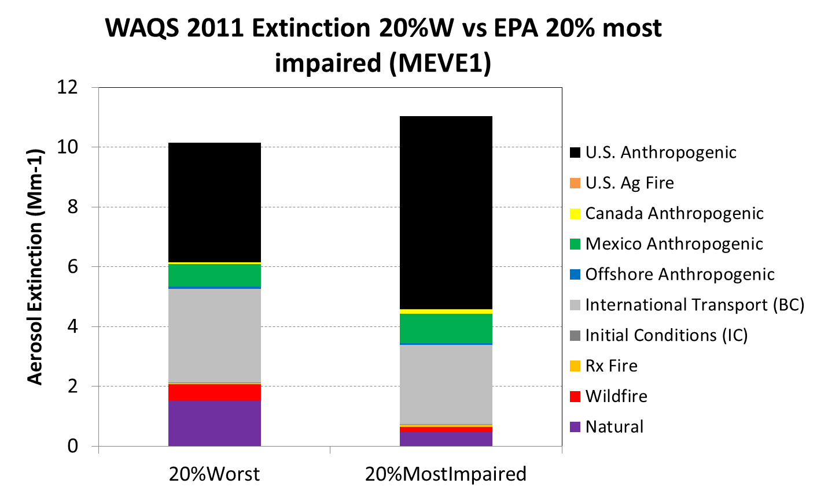
Source apportionment model results for Worst vs. Most Impaired quintiles

Slide 34
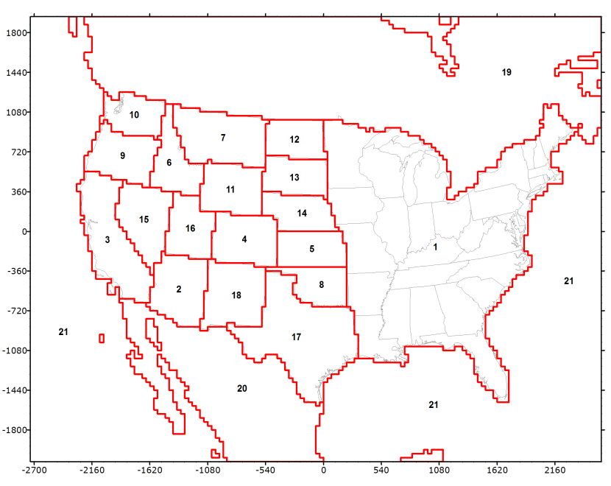
CAMx most impaired days visibility metric approach using 2008 and 2011 modeling results
2008 CAMx PSAT source apportionment modeling for WestJumpAQMS; https://www.wrapair2.org/WestJumpAQMS.aspx)
2011 CAMx PSAT for Western Air Quality Study (WAQS) available through the Intermountain West Data Warehouse (IWDW; http://views.cira.colostate.edu/tsdw/)
Controllable:
U.S. Anthropogenic Emissions
U.S. Agricultural Burning
Uncontrollable:
Biogenic, Sea Salt, Lightning, WBD
Wildfires and Prescribed Burns
Non-U.S. Anthro Emissions (Mex/Can)
Boundary Conditions (International Transport)

Slide 35
Key Questions for Round 2 RHR Planning
What are visibility trends 2000-present?
Which pollutants are most important?
Implement new tracking metric
Which emissions are most important?
Apply source attribution model
Reconcile links between emissions and haze
Vary by season, meteorology, transport, into future
International emissions are both anthro and natural
Need model to investigate in-state, interstate, non-US anthropogenic, natural contributions

Slide 36
Is Fire a Natural or Anthropogenic Source? It depends….
http://www.ecy.wa.gov/programs/air/indoor_woodsmoke/smoke_page.htm

Slide 37
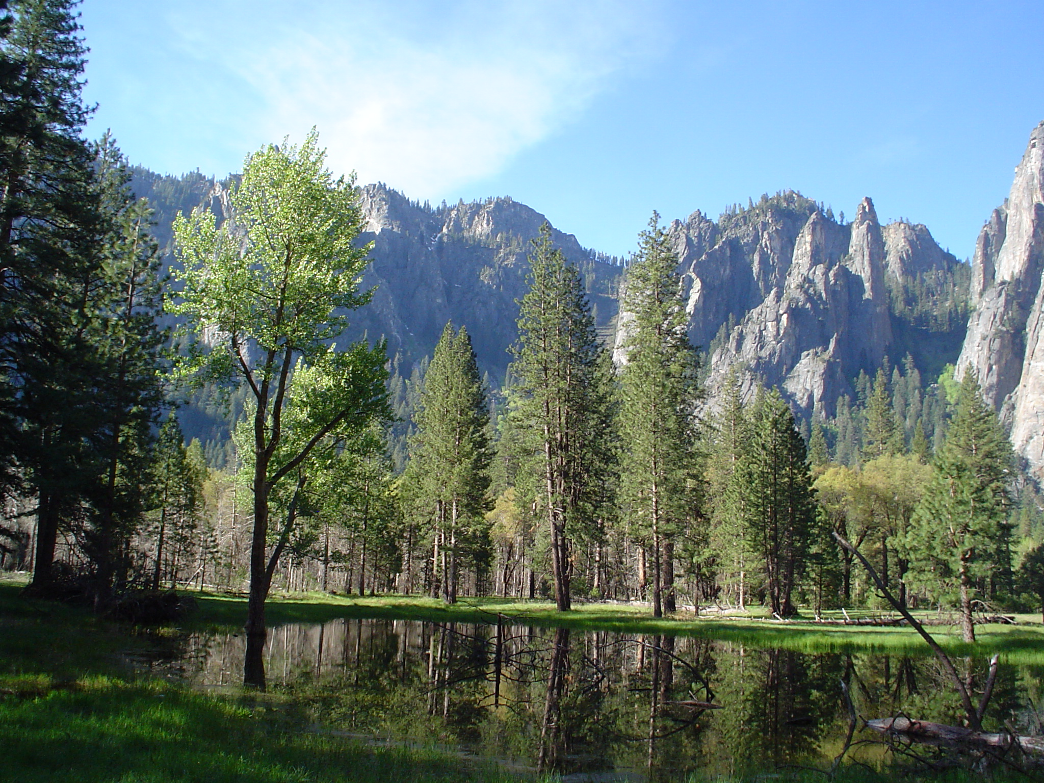
Regional collaboration is essential for sound science and policy
Yosemite National Park - Cathedral Rocks

